Slide 1

JAVA PROJECT • CONSOLE APPLICATION
Intercity Bus
Reservation
Simulator
A simple way to explore routes, reserve seats, and calculate fares with confidence.
TRAVEL SMART • BOOK EASY
PROJECT PRESENTATION
Notes:
Title slide: Intercity Bus Reservation Simulator, a Java console application project.

Slide 2

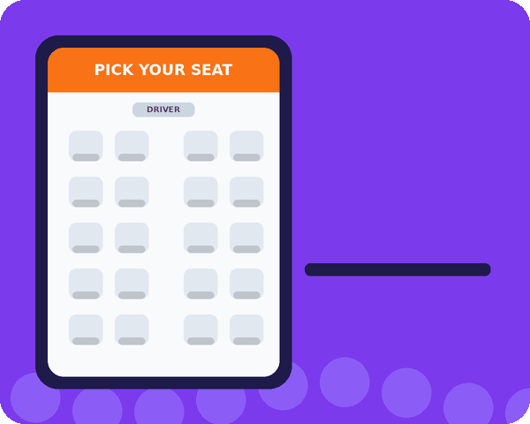
02
Abstract
A Java-based console application for intercity travel
ABOUT THE SYSTEM
The Intercity Bus Reservation System simplifies viewing available buses and reserving tickets for intercity journeys.
PURPOSE
1
View bus and route information
2
Select a bus and reserve tickets
3
Check seat availability before confirmation
4
Calculate fare and applicable discount automatically
A clear, menu-driven booking experience
5
Update remaining seats after a successful reservation
Notes:
The system lets a user view buses and routes, reserve tickets, check seats, get fares with discounts, and update seats.

Slide 3

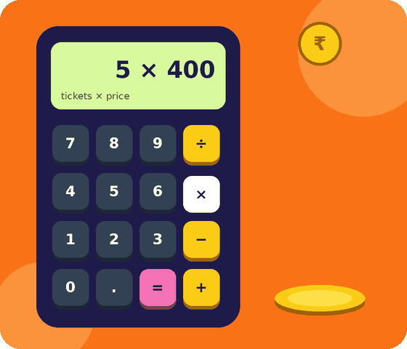
03
How Data Is Processed
Variables and operators turn ticket inputs into a final fare
CONCEPTS USED
double totalAmount = tickets * prices[index];
double discount = 0;
if (tickets >= 5) {
discount = totalAmount * 0.10;
}
double finalAmount = totalAmount - discount;
Variables & the double type
Arithmetic & assignment
Expressions
Relational operators
Why it matters
The program calculates the total, checks discount eligibility, and finds the final amount.
01
Calculate total
02
Check discount
03
Find final fare
tickets × price
5+ tickets → 10% off
total − discount
Notes:
Fare = tickets × price; 10% discount when tickets ≥ 5; final = total − discount.

Slide 4

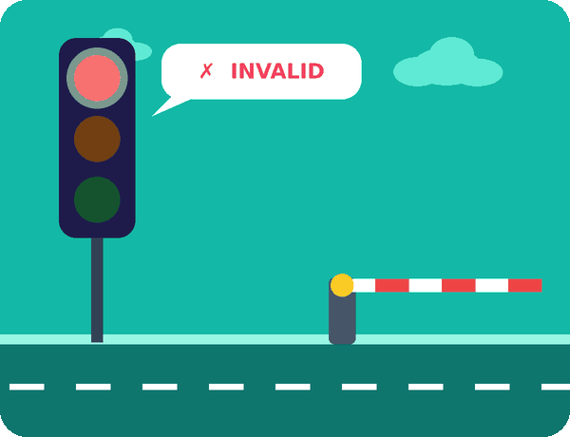
04
Selection & Decision Making
The program responds differently to valid and invalid inputs
CONCEPTS USED
if-else validates ticket quantity and seat availability
if (tickets >= 5) applies a 10% discount
switch-case controls the main menu
default handles an invalid menu choice
break prevents fall-through into another case
if (tickets <= 0) {
System.out.println("Number of tickets must be greater than 0.");
} else if (tickets <= seats[index]) {
// Continue with fare calculation
}
Input
Validate
Continue / Error
Without selection statements, the system could not respond to different situations.
Notes:
Red light = invalid input, green = valid input: the gate opens only when validation passes.

Slide 5
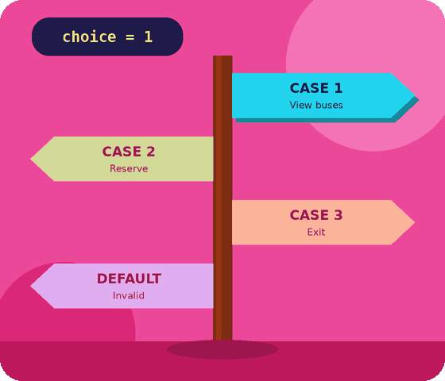
05
Switch-case: Menu Selection
A simple menu routes the user to the correct operation
WHAT THE USER SEES
switch (choice) {
case 1:
// View Available Buses
break;
case 2:
// Reserve Tickets
break;
case 3:
// Exit
break;
default:
// Invalid choice
}
1. View Available Buses
2. Reserve Tickets
3. Exit
Any other number?
Each case maps a menu number to one action; break stops it there.
The default branch handles any choice outside the listed options.

Slide 6
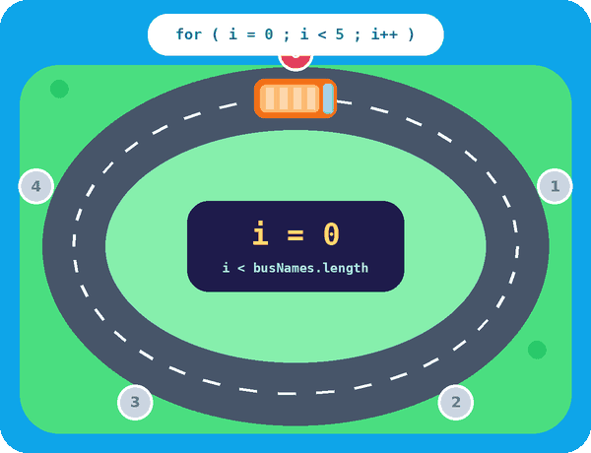
06
Loops
Automation helps the system display buses and repeat the menu
FOR LOOP
Why it matters
Instead of writing separate code for every bus, the loop displays all buses automatically.
for (int i = 0; i < busNames.length; i++) {
// display bus details
}
DO-WHILE LOOP
Why it matters
The menu keeps appearing until the user chooses Exit.
do {
// menu
} while (choice != 3);
One lap, every stop: i goes 0 → 4

Slide 7

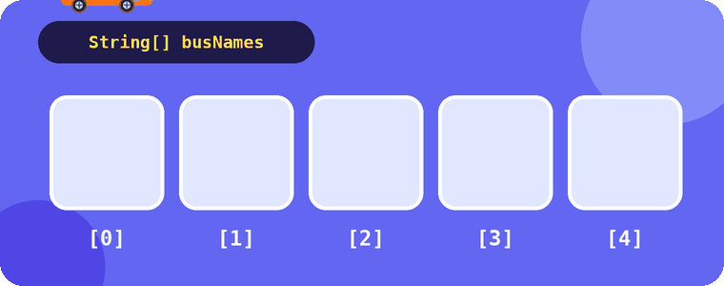
07
Methods & Arrays
Keep the code organised and manage multiple buses efficiently
METHODS
ARRAYS
displayBuses(busNames,
routes, seats, prices);
reserveTicket(sc, busNames,
routes, seats, prices);
1
Divide the program into smaller sections
Make code easier to understand
Why it matters
Arrays store related values for several buses, making the data easier to access and manage.
2
String[] busNames;
String[] routes;
int[] seats;
double[] prices;
3
Avoid repeating the same code
4
Make debugging easier

Slide 8
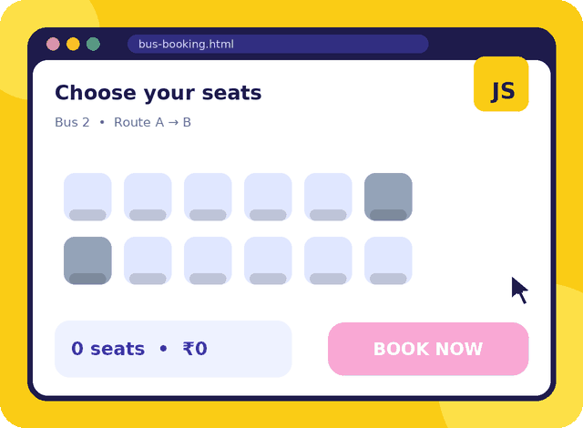
08
JavaScript: Web Interface
For an interactive browser-based booking experience
POSSIBLE FRONT-END RESPONSIBILITIES
1
Handle user interactions such as form input and button clicks
2
Validate passenger details and ticket quantity
3
Update visible seat and fare information dynamically
4
Give immediate feedback when an input needs attention
5
Make the booking interface feel responsive
JavaScript makes a web interface interactive; Java handles the console application's core logic.

Slide 9
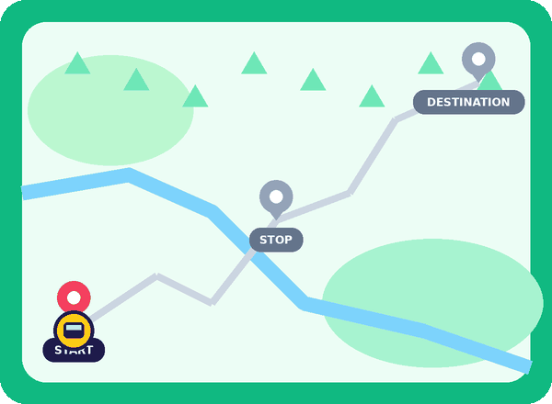
09
Working Principle of the System
From bus data to a confirmed reservation
1
2
3
4
Store bus data
Display menu
Show buses
User input
Names, routes, seats & prices in arrays
User chooses an operation
List buses and their details
Bus number, name & ticket count
5
6
7
8
Validate booking
Calculate fare
Update seats
Confirm
Steps 1 → 8 run every time a passenger books, and the menu repeats until Exit.
Check input and seat availability
10% off for 5 or more tickets
Subtract booked seats
Show reservation details

Slide 10

THANK YOU
Intercity Bus Reservation Simulator
Simple
Smart
Reliable
PROJECT TEAM
Tony Sainipun Information Gathering
Viloch PPT
S. Satvik Code

